Slide 1
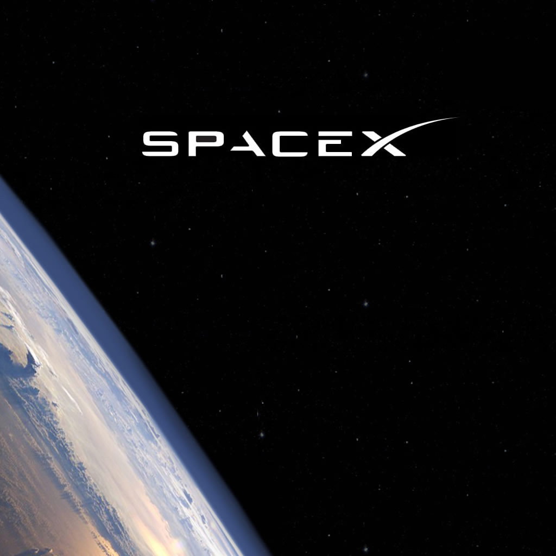
The private space.
Beginning…

Slide 2
Agenda
SpaceX company.
Founder and inspirer.
Dragon spaceship
Falcon 9 carrier
Missions executed.
Comparison of existing rocket carriers.
Looking to the future:
Falcon Heavy.
Dragon Crew.
Future SpaceX rockets

Slide 3
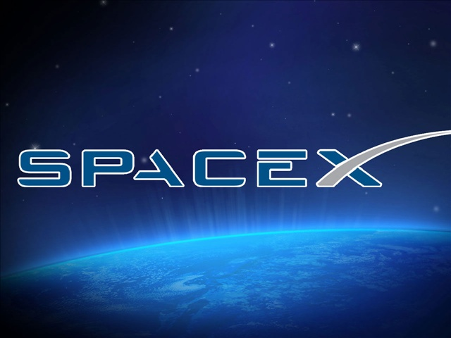
Notes:
It is the only private company ever to return a spacecraft from low-Earth orbit, which it first accomplished in December 2010. The company made history again in May 2012 when its Dragon spacecraft attached to the International Space Station, exchanged cargo payloads, and returned safely to Earth — a technically challenging feat previously accomplished only by governments. Since then Dragon has delivered cargo to and from the space station multiple times, providing regular cargo resupply missions for NASA.
Under a $1.6 billion contract with NASA, SpaceX will fly numerous cargo resupply missions to the ISS, for a total of at least 12 —and in the near future, SpaceX will carry crew as well. Dragon was designed from the outset to carry astronauts and now, under a $440 million agreement with NASA, SpaceX is making modifications to make Dragon crew-ready. SpaceX is the world’s fastest-growing provider of launch services. Profitable and cash-flow positive, the company has nearly 50 launches on its manifest, representing close to $5 billion in contracts. These include commercial satellite launches as well as NASA missions.
Currently under development is the Falcon Heavy, which will be the world’s most powerful rocket. All the while, SpaceX continues to work toward one of its key goals—developing reusable rockets, a feat that will transform space exploration by delivering highly reliable vehicles at radically reduced costs.

Slide 4

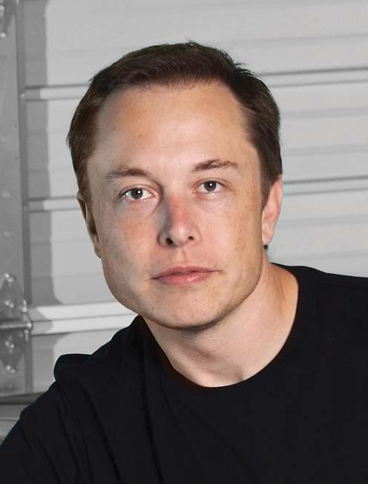



Elon Musk
Notes:
SpaceX is the third company founded by Musk. Musk’s other primary activity is serving as CEO and
Product Architect of Tesla Motors; Musk is also the non-executive chairman of SolarCity, the leading
provider of solar power systems in California. At SpaceX, Musk served as chief engineer for Falcon 1,
the first privately developed liquid fuel rocket to achieve Earth orbit, as well as Falcon 9 and the
Dragon spacecraft. Prior to SpaceX, Musk co-founded PayPal, the world’s leading electronic payment
system, and served as the company’s chairman and CEO. Musk has won a series of awards, including being named one of the 75 most influential people of the
21st century by Esquire magazine and recognition as a Living Legend in Aviation by the Kitty Hawk
Foundation. Musk holds a Physics degree from the University of Pennsylvania, a Business degree from
Wharton, and currently serves as a member of the Stanford University Engineering Advisory Board.

Slide 5
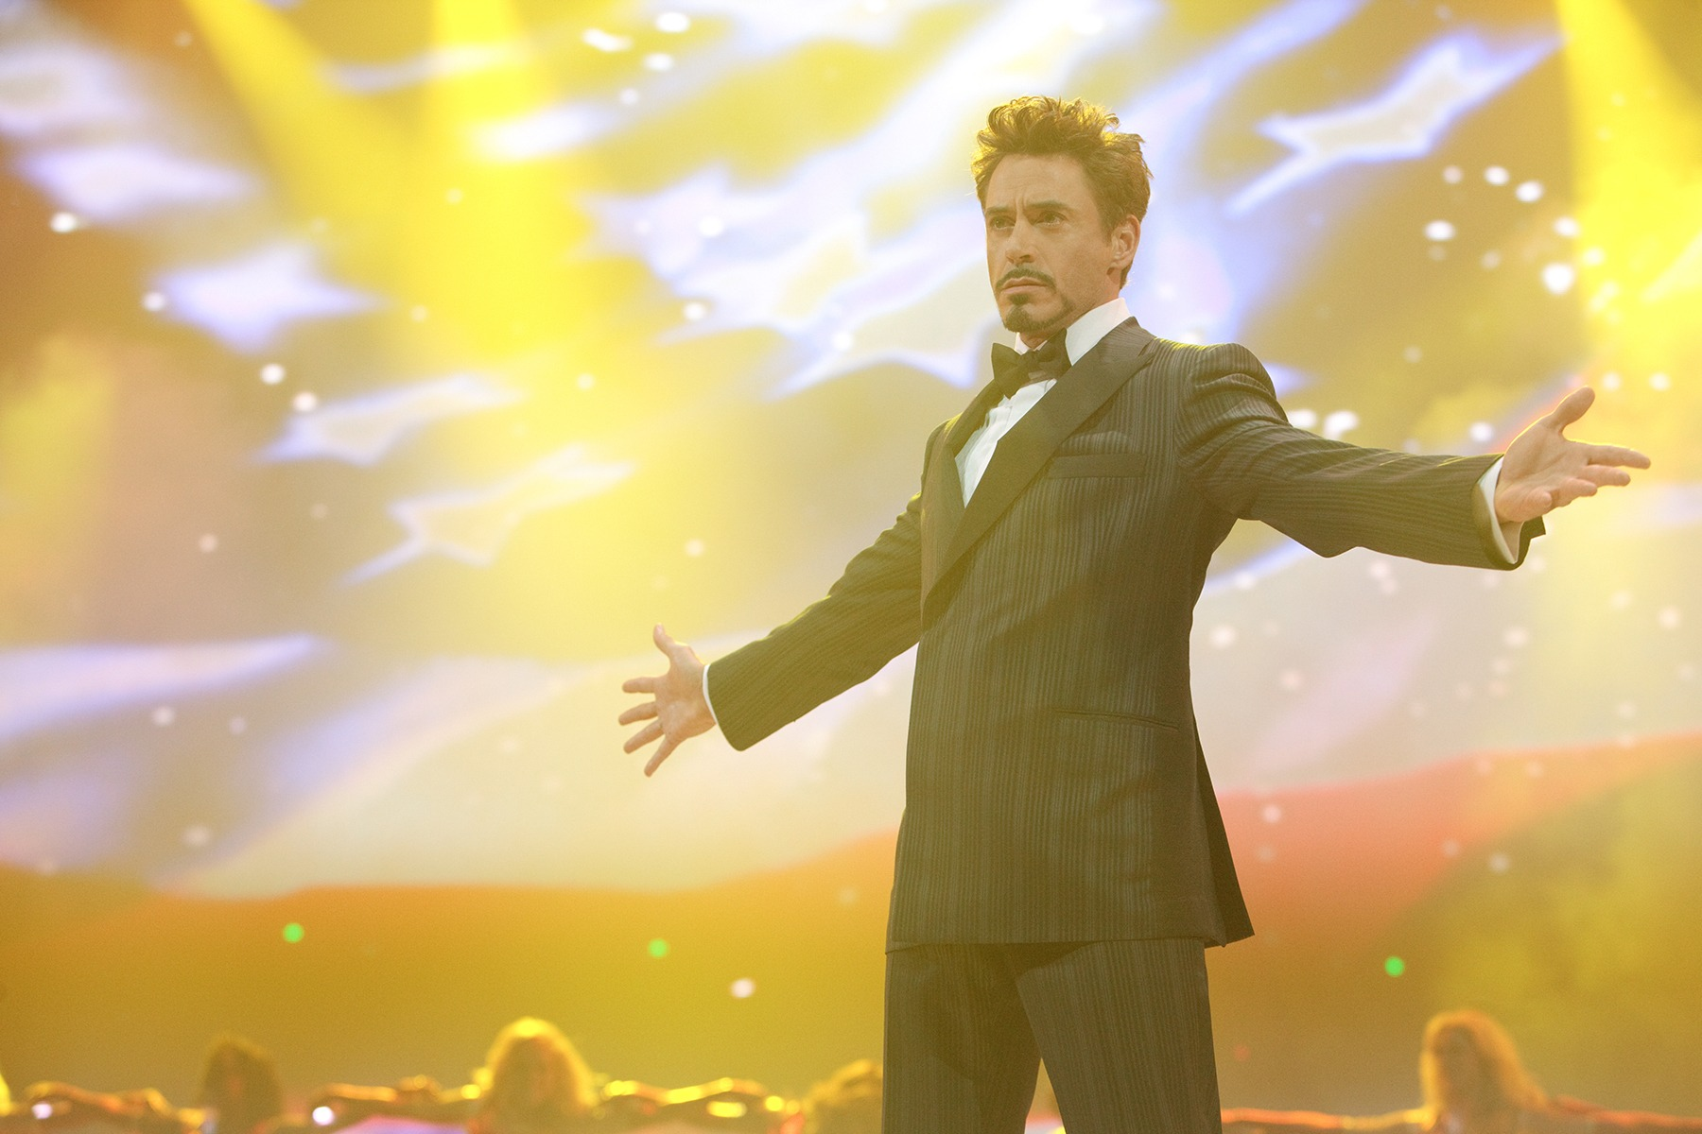

Slide 6
Falcon 9 rocket
Falcon 9 is a two-stage rocket designed and manufactured by SpaceX for the reliable and safe transport of satellites and the Dragon spacecraft into orbit. As the first rocket completely developed in the 21st century, Falcon 9 was designed from the ground up for maximum reliability. Falcon 9’s simple two-stage configuration minimizes the number of separation events -- and with nine first-stage engines, it can safely complete its mission even in the event of an engine shutdown.
Falcon 9 made history in 2012 when it delivered Dragon into the correct orbit for rendezvous with the International Space Station, making SpaceX the first commercial company ever to visit the station. Since then SpaceX has made a total of three flights to the space station, both delivering and returning cargo for NASA. Falcon 9, along with the Dragon spacecraft, was designed from the outset to deliver humans into space and under an agreement with NASA, SpaceX is actively working toward that goal.

Slide 7
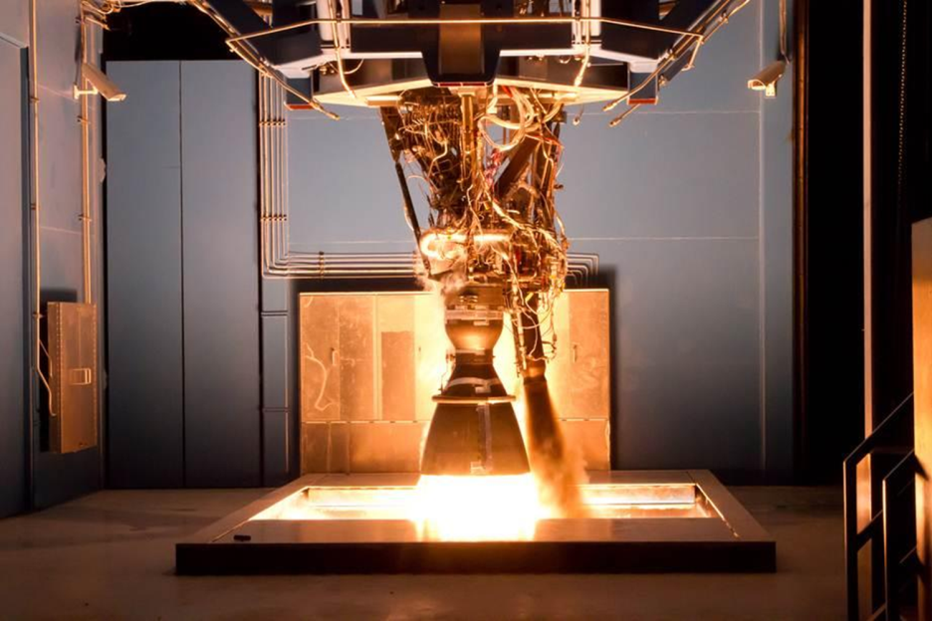
The Merlin engine that powers the first stage of Falcon 9 is developed and manufactured in-house by SpaceX . Burning liquid oxygen and rocket-grade kerosene propellant, a single Merlin engine emits 654 kilonewtons (147,000 pounds) of thrust at liftoff, rising to 716 kilonewtons (161,000 pounds) as it climbs out of Earth’s atmosphere. Merlin’s thrust-to-weight ratio exceeds 150, making the Merlin the most efficient booster engine ever built, while still maintaining the structural and thermal safety margins needed to carry astronauts.

Slide 8
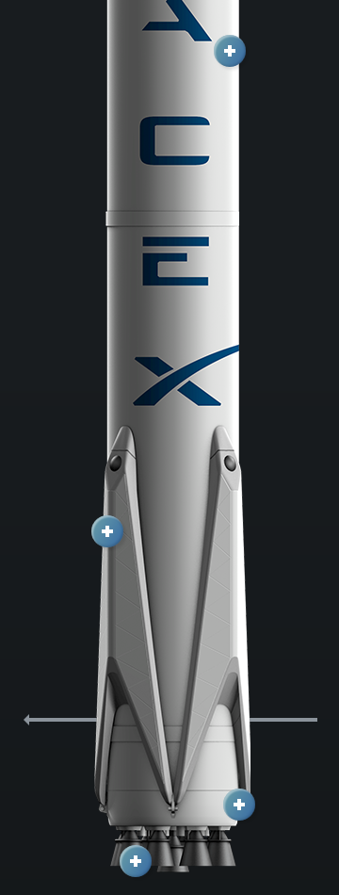
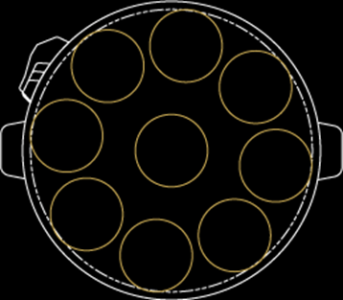
First Stage
Notes:
Falcon 9’s first stage incorporates nine Merlin engines and aluminum-lithium alloy tanks containing liquid oxygen and rocket-grade kerosene (RP-1) propellant. After ignition, a hold-before-release system ensures that all engines are verified for full-thrust performance before the rocket is released for flight. Then, with thrust greater than five 747s at full power, the Merlin engines launch the rocket to space. Unlike airplanes, a rocket's thrust actually increases with altitude; Falcon 9 generates 1.3 million pounds of thrust at sea level but gets up to 1.5 million pounds of thrust in the vacuum of space. The first stage engines are gradually throttled near the end of first-stage flight to limit launch vehicle acceleration as the rocket’s mass decreases with the burning of fuel.

Slide 9
Second Stage

Slide 10
Dragon Spacecraft
Notes:
Dragon carries cargo in the spacecraft’s pressurized capsule and unpressurized trunk, which can also accommodate secondary payloads. In the future, Dragon will carry astronauts in the pressurized capsule as well.
Dragon is a free-flying spacecraft designed to deliver both cargo and people to orbiting destinations. Dragon made history in 2012 when it became the first commercial spacecraft in history to deliver cargo to the International Space Station and safely return cargo to Earth, a feat previously achieved only by governments. It is the only spacecraft currently flying that is capable of returning significant amounts of cargo to Earth. Currently Dragon carries cargo to space, but it was designed from the beginning to carry humans. Under an agreement with NASA, SpaceX is now developing the refinements that will enable Dragon to fly crew. Dragon's first manned test flight is expected to take place in 2-3 years.

Slide 13
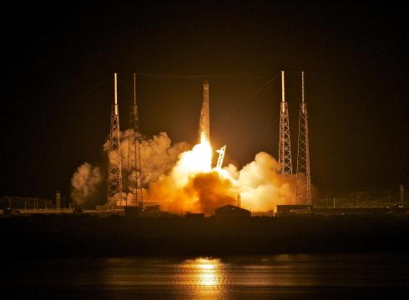
Missions executed
SpX-C1 (COTS 1) - 8 December 2010
SpX-C2+ (COTS 2) - 22 May 2012
SpaceX CRS-1 - 8 October 2012
SpaceX CRS-2 - 1 March 2013
SpaceX CRS-3 - 18 April 2014
Notes:
8 launches 5 mission
SpX-C1 (COTS 1) 8 December 2010 First Dragon mission, second Falcon 9 launch
SpX-C2+ (COTS 2) 22 May 2012 First Dragon mission with complete spacecraft, first rendezvous mission, first berthing with ISS
SpaceX CRS-1 8 October 2012 First Commercial Resupply Services (CRS) mission for NASA, first non-demo mission. Falcon 9 rocket suffered a partial engine failure during launch but was able to deliver Dragon into orbit. However, a secondary payload did not reach its correct orbit. Mission success; launch anomaly
SpaceX CRS-2 1 March 2013 First launch of Dragon using trunk section to carry cargo. Launch was successful, but anomalies occurred with the spacecraft's thrusters shortly after liftoff. Thruster function was later restored and orbit corrections were made, but the spacecraft's rendezvous with the ISS was delayed from its planned date of 2 March until 3 March, when it was successfully berthed with the Harmony module. Dragon splashed down safely in the Pacific Ocean on 26 March. Mission success; spacecraft anomaly
SpaceX CRS-3 18 April 2014] First launch of the redesigned Dragon: same outer mold line with the avionics and cargo racks redesigned in order to supply substantially more electrical power to powered cargo devices, including additional cargo freezers for transporting critical science payloads.^{[87]} Rescheduled for the 18th due to a helium leak. Mission success; Operational^{[117]}

Slide 14
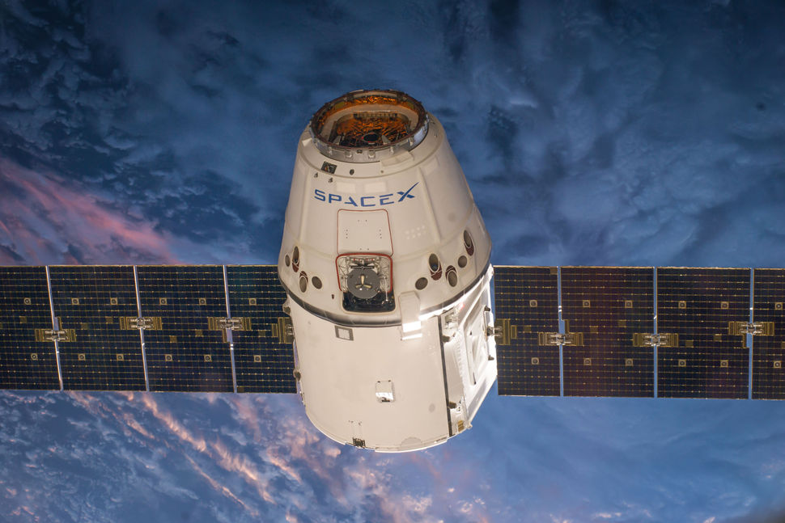

Slide 15
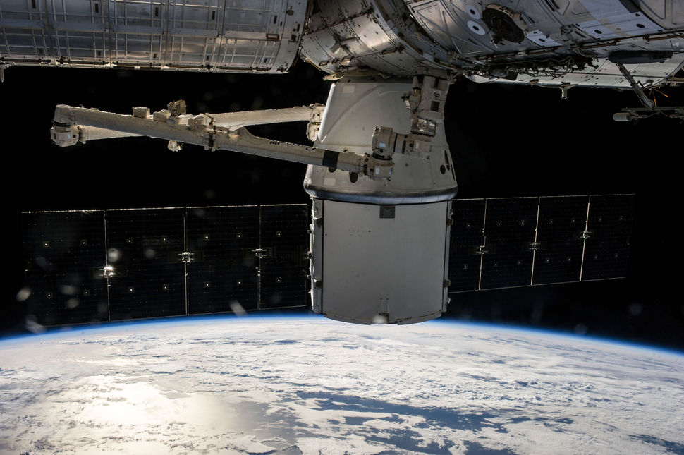

Slide 16
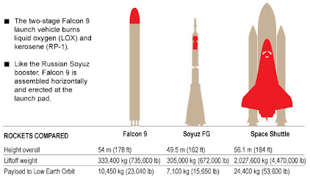
Comparison of existing rocket carriers

Slide 17
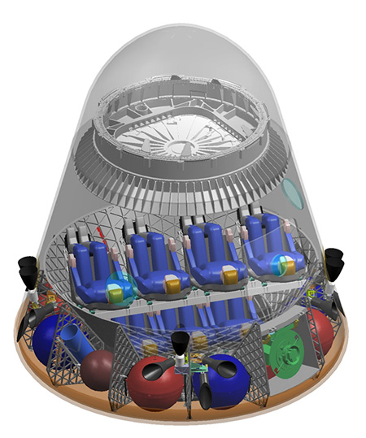
DragonRider, the crewed variant of Dragon
Notes:
DragonRider, the crewed variant of Dragon, will support a crew of seven or a combination of crew and cargo.[91][92] It is planned to be able to perform fully autonomous rendezvous and docking with manual override capability; and will use the NASA Docking System (NDS) to dock to the ISS.[19][93] For typical missions, DragonRider would remain docked to the ISS for a period of 180 days; it is required to be able to do so for 210 days, the same as the Russian Soyuz spacecraft.[94][95][96] SpaceX plans to use an integrated pusher launch escape system for the Dragon spacecraft, with several claimed advantages over the tractor detachable tower approach used on most prior crewed spacecraft.[97][98][99] These advantages include the provision for crew escape all the way to orbit, reusability of the escape system, improved crew safety due to the elimination of a stage separation, and the ability to use the escape engines during the landing phase for a precise solid earth landing of the Dragon capsule.[100] An emergency parachute will be retained as a redundant backup for water landings.[100]
The Paragon Space Development Corporation is assisting in the development of DragonRider's life support system.[101] SpaceX is also in talks with Orbital Outfitters regarding the development of a spacesuit that would be worn during launch and re-entry.[102]
At a NASA news conference on 18 May 2012, SpaceX confirmed again that their target launch price for crewed Dragon flights is $140,000,000, or $20,000,000 per seat if the maximum crew of 7 is aboard, and if NASA orders at least four DragonRider flights per year.[103] This contrasts with the 2012 Soyuz launch price of $63,000,000 per seat for NASA astronauts.[104]

Slide 18
Falcon Heavy

Slide 19
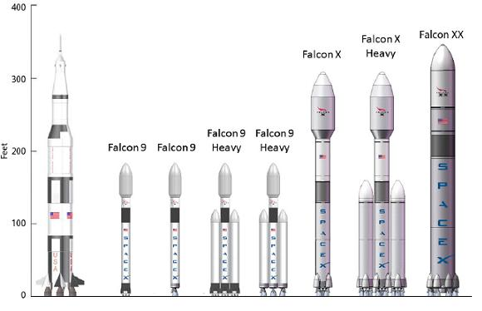
future spacex rockets

Slide 20
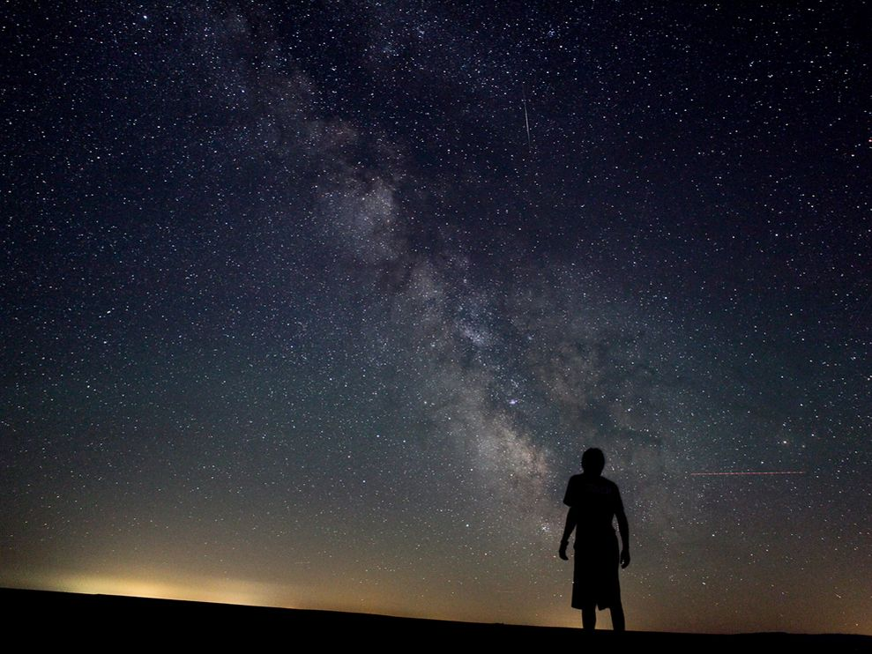
Space: the final frontier.
Q&A

